Slide 1
osteoarthritis
Esmaeili ~ Esquivel ~ Fernandez ~Ferrandiz ~ Flores ~ Francisco ~ Gansatao ~ Gatmaitan ~ Golpeo ~ Gutierrez

Slide 2
Approach to musculoskeletal complaint
Anatomic Localization of Complaint
Chronology
Nature of Pathologic Process
Extent of Involvement
Articular or Non-Articular?
< or > 6 Weeks?
Inflammatory or Not?
Which joints?

Slide 3
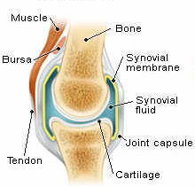
Articular vs non-articular
Non-Articular Structures
Extra-articular ligaments
Tendons
Bursae
Muscle
Fascia
Bone
Nerve
Overlying skin
Articular Structures
Synovium
Synovial Fluid
Articular cartilage
Intraarticular ligaments
Joint capsule
Juxtaarticular bone

Slide 4
Articular vs non-articular
Features of Articular
Deep or diffuse Pain
Pain or Limited ROM on active and passive movement
Swelling
Crepitation
Instability
“Locking”
Deformity
Features of Non-Articular
Point or focal tenderness
Painful of active ROM
Seldom demonstrate swelling, crepitation, instability or deformity

Slide 5
$$✓$$
$$✓$$

Slide 6
Approach to musculoskeletal complaint
Anatomic Localization of Complaint
Chronology
Nature of Pathologic Process
Extent of Involvement
Articular or Non-Articular?
< or > 6 Weeks?
Inflammatory or Not?
Which joints?

Slide 7
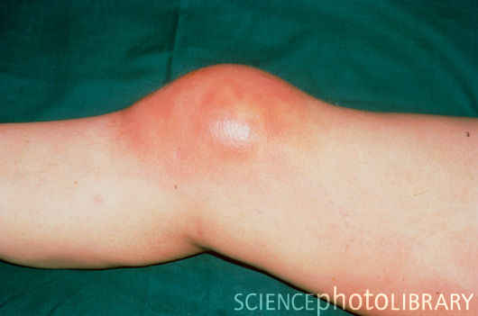
Inflammatory vs non-inflammatory
Cardinal signs of inflammation
Systemic symptoms
Laboratory evidence
Prolonged morning stiffness
Notes:
Inflammatory – infections, crystal-induced, immune-related, reactive or idiopathic
Cardinal signs – erythema, warmth, pain, swelling
Systemic Symptoms – Fatigue, fever, rash, weight loss
Laboratory evidence – ESR, CRP, thrombocytosis, etc
Morning stiffness – inflammatory – ppted by prolonged rest, severe, lasts for hours, may improve with activity and anti-inflamm medications
Morning stiffness – non-inflammatory – intermittent stiffness (gel phenomenon), ppted by brief periods of rest, lasts <60mins, exacerbated by activity;

Slide 8
Approach to musculoskeletal complaint
Anatomic Localization of Complaint
Chronology
Nature of Pathologic Process
Extent of Involvement
Articular or Non-Articular?
< or > 6 Weeks?
Inflammatory or Not?
Which joints?

Slide 9
$$✓$$
$$✓$$

Slide 10
OSTEOARTHRITIS
Articular
Chronic
Non-inflammatory
Hip, DIP, PIP

Slide 11
Osteoarthritis
Represents failure of the diarthrodial joint.
The most common joint disease in humans
Joint failure due to impaired joint protective mechanisms

Slide 12
Joint Failure
Joint failure occurs in the setting of loss of protective mechanisms
Joint protectors include:
Joint capsule and ligaments, synovial fluid
Muscle
Sensory afferents
Bone

Slide 13
Classification
Idiopathic
Localized
Hands
Feet
Knee
Hip
Spine
Other single sites, e.g., glenohumoral, acromioclavicular, tibiotalar, sacroiliac, temporomandibular
Generalized includes 3 or more of the area listed above

Slide 14
Classification
Secondary
Trauma
Congenital or developmental
Metabolic
Endocrine
Calcium deposition diseases
Neuropathic
Endemic
Miscellaneous
Frosbite
Caisson’s disease
hmoglobinopathies

Slide 15
I. Systemic Risk Factors
Age – most powerful risk factor. 2% prevalence among women <45years, 30% among 45-64 years and 68% among >65 years.
Cartilage are less responsive to stimulus for synthesis of matrix. Muscles and joints are less responsive to incoming loading movement.
Sensory nerve impulses are also slowed down with age thus halting the feedback mechanism of mechanoreceptor

Slide 16
Sex – more common in older women, possibly due to loss of estrogen during menopause.
Hip OA more common in male
Interphalangeal and thumb base OA more in women
Genetics – a woman with mother and sister affected with interphalangeal OA is 2-3x at risk
Race – Hip OA is less common in Chinese than Caucasians. OA more in Native Americans than in Caucasians.

Slide 17
II. Intrinsic Joint Vulnerabilities
Congenital hip diseases such as Legg-Perthes disease increase focal stress to hip joints increasing susceptibility to OA later in life.
Knee anomalies and malalignment such as Varus and Valgus deformity.

Slide 18
III. Loading Factors
Obesity – most potent risk factor for hip and knee OA. There is a linear relationship between risk of OA and increase in weight. 5kg weight loss is associated with 50% risk reduction.
Repetitive joint use – among miners, farmers, and runners.

Slide 19
Risk Factors

Slide 20
Pathogenesis
The biomaterial properties of the articular cartilage and subchondral bone are normal, but excessive loading of the joint causes the tissues to fail.
The applied load is reasonable but the material properties of the cartilage or bone are inferior.
Decrease in polypeptide mediators which regulates biosynthesis of PGs responsible for compressive stiffness of tissue and withstand load.
Increase in IL-1 leading to suppression of PG synthesis and inhibiting matrix repair.

Slide 21
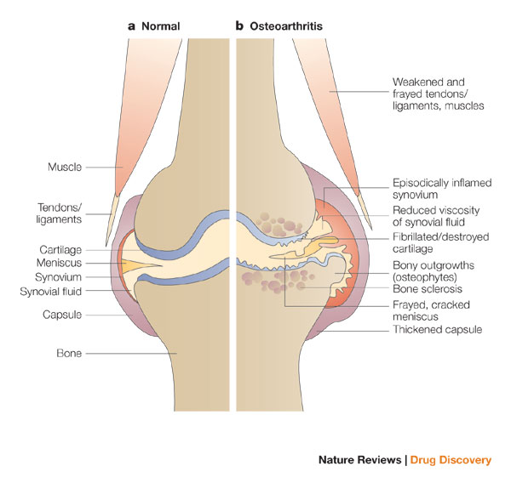
Pathogenesis
Hyaline cartilage loss.
Chrodrocytes attempts repair. Also stimulating inflammatory cytokine
Cartilage break down, bone exposure and development of subchondral cyst
Subchondral plate sclerosis, osteophyte growth and sinovitis.
Weakness of muscle bridging
Notes:
Stretching

Slide 22
Clinical features

Slide 23
Clinical features
Joint stiffness / morning stiffness (<30 mins)
Joint pain (activity-related)
Episodic
Trigerred often by a day or two of overactive use of a diseased joint
Nocturnal pain
Mechanical symptoms: buckling, catching, or locking.
Limitation of joint movement
Deformity

Slide 24
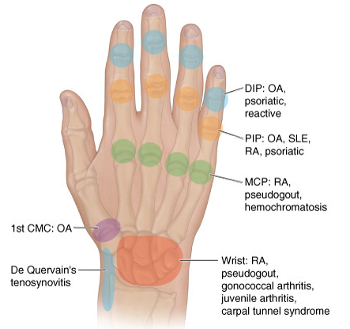

Slide 25
differentials
 | Osteoarthritis | Rheumatoid arthritis | Gouty arthritis
Duration | Episodic | Weeks to months | Episodic
Location | Weight bearing joints(knee or hip) | Hands, wrists, knees, and feet | Metatarsophalangeal joint of the first toe, tarsal joints, ankle and knees
Clinical Features | -Joint stiffness/ morning stiffness (<30 mins) -Joint pain (activity-related) -Episodic -Trigerred often by a day or two of overactive use of a diseased joint -Nocturnal pain -Limitation of joint movement -Deformity | -swelling -chronic polyarthritis -Joint stiffness/ morning stiffness (>1 hour) -pain aggravated by movement -tenderness -Fever >38C -Lymphadenopathy -Splenomegaly -Weakness, easy fatigability, anorexia, weight loss | -Acute or subacute worsening pain -swelling

Slide 26
 | Osteoarthritis | Rheumatoid arthritis | Gouty arthritis
Radiologic changes | -Meniscal tear on cartilages -bone lesions -narrowes joint space -sclerosis of the bone -osteophytes | -cystic changes -well-defined erosions with sclerotic margins (often with overhanging bony edges) -soft tissue masses | -juxtaarticular osteopenia (within weeks) -loss of articular cartilage and bone erosions (months)
Laboratory work-up | -Synovial fluid leukocyte <1000/µL | -Rheumatoid factor -Erythrocyte sedimentation rate -Normochromic normocytic anemia | -Synovial fluid leukocyte 2000-60,000/L -effusions appear cloudy -crystals in synovial fluid

Slide 27
diagnostics

Slide 28
Laboratory tests
No blood tests are routinely indicated
Examination of the synovial fluid is to rule out other causes of the pain and swelling.

Slide 29
Imaging methods
X-ray
Joint Space Narrowing
Development of Osteophytes
Subchondral Sclerosis
Subchondral Cyst Formation
Subluxation
Notes:
Joint Space Narrowing
Osteoarthritis causes deterioration of the joint structures. Wearing away or deterioration of articular cartilage leads to narrowing of the joint space (i.e., the space between the end of bones in a joint). Progressively smaller joint space suggests worsening of osteoarthritis. Joint space loss is usually not uniform within the joint. "Bone-on-bone" suggests there is no joint space left.
Development of Osteophytes
Osteophytes, also called bone spurs, are protrusions of bone and cartilage. The bony projections are commonly seen in areas of a degenerating joint and can be seen on x-rays. Osteophytes, which typically develop as a reparative response by remaining cartilage, cause pain and limited range of motion in the affected joint.
Subchondral Sclerosis
Subchondral bone is the layer of bone just below the cartilage. Sclerosis means that there is hardening of tissue. Subchondral sclerosis is seen on x-ray as increased bone density, frequently found adjacent to joint space narrowing. The degeneration of bone which occurs in osteoarthritis causes bone to turn into a dense mass at the articular surfaces of bone.
Subchondral Cyst Formation
Subchondral cysts are fluid-filled sacs which extrude from the joint. The cysts contain thickened joint material, mostly hyaluronic acid. Traumatized subchondral bone undergoes cystic degeneration.
Subluxation
Subluxation can also be seen on x-ray as a possible consequence of osteoarthritis. Subluxation is a partial dislocation of a bone.

Slide 30
Imaging methods

Slide 31
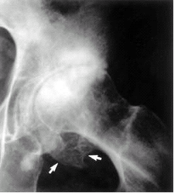
Notes:
Severe osteoarthritis of the hip. The joint space is narrowed, and there is subchondral sclerosis with scattered oval radiolucent cysts and peripheral osteophyte lipping (arrows).

Slide 32
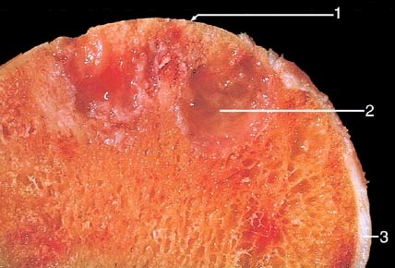
Notes:
Severe osteoarthritis with small islands of residual articular cartilage next to exposed subchondral bone. 1, Eburnated articular surface. 2, Subchondral cyst. 3, Residual articular cartilage.

Slide 33
treatment

Slide 34
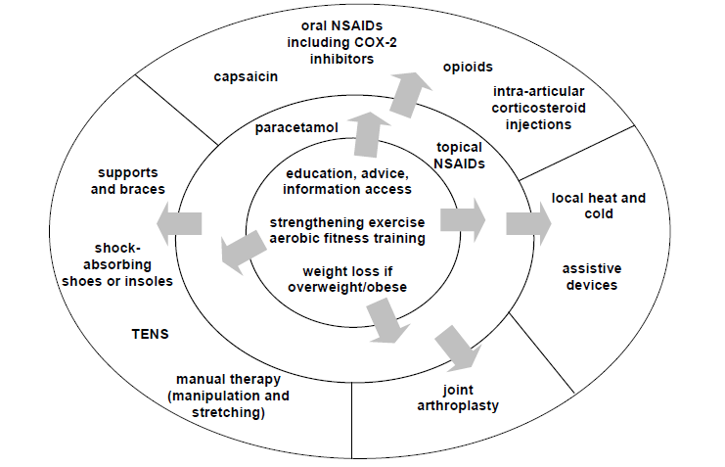
Treatment goals
Pain reduction
Maintenance of mobility
Minimization of disability
NICE Clinical Guideline 59

Slide 35
Pharmacologic treatment
Paracetamol → first line drug for mild pain; max dose of 4g/day; close monitoring of upper GI adverse events
Tramadol → control of moderate pain and improvement in knee function
Oral NSAIDs and COXIBs → small to moderate effect in reducing exacerbations of knee OA; up to 2 weeks duration
Topical NSAIDs → control of symptomatic or acute exacerbation of knee OA and improvement of function
(PRA Practice Guidelines)

Slide 36
Pharmacologic treatment
Intraarticular Steroids → effective and safe for moderate symptomatic exacerbations of knee OA; with effects up to 1-3 weeks (PRA Practice Guidelines)
Rubefacients / Capsaicin → for reduction of joint pain and tenderness
Intraarticular Hyaluronic Acid → for moderate pain and improvement in function; 3-5 weekly injections; longer duration of action than steroids (PRA Practice Guidelines)

Slide 37
Non-pharmacologic treatment
Reduction of Joint Loading
Rest but not complete immobilization
Except in hand OA: DIP joint OA > custom-made splint to block flexion, improve overall hand function and reduce muscle spasm
Splinting
Effective for trapeziometacarpal joint and pantrapezial OA

Slide 38
Non-pharmacologic treatment
Patient Education
Provide additive benefit 20 to 30% as great as that of NSAID alone
Taking medications properly and communicating with health care providers
Decreases pain, disability and depression

Slide 39
Heat reduces pain and stiffness → Hot shower or bath
Better analgesia with ice than heat
Wedged insoles / orthoses
(polypropylene mesh insole = inexpensive and practical) - useful in OA
of the medial tibial compartment
Reduction of joint contact forces
Unilateral OA → cane should be held on contralateral side
Bilateral Disease → crutches or walker

Slide 40
Disuse of OA joint will lead to muscle atrophy
Periarticular muscles protects articular cartilage from stress hence strengthening exercises are important
Studies showed decreased pain, anxiety and depression with exercise
Weight loss for obese patients reduces joint loading
→ 5% weight reduction significantly improves pain and
function (PRA Practice Guidelines)

Slide 41
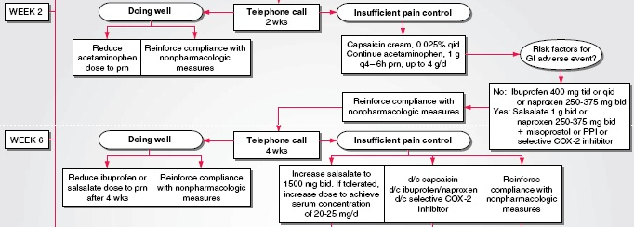

Slide 42
PATELLAR TAPING
Patellofemoral compartment → severe pain
Taping of patella reduces pain with isometric exercise to strengthen vastus medialis obliquus component of quadriceps → realignment of patella on a long term basis

Slide 44
ORTHOPEDIC SURGERY
Tidal irrigation of the knee
Arthroscopic debridement and lavage
Joint replacement for advanced OA
Joint arthroplasty may relieve pain and increase mobility
Osteotomy can eliminate concentration of peak dynamic loads and provides pain relief
Cartilage regeneration

Slide 45
references
Fauci, A.S et al (2008) Harrison’s Principles of Internal Medicine (17th ed) NY: McGraw Hill Co, Inc.
National Institute for Health and Clinical Excellence (2008) “Osteoarthritis: The care and management of osteoarthritis is adults.” NICE Clinical Guideline 59. London: NHS.
Philippine Rheumatology Association (n.d.) “PRA Clinical Practice Guidelines for the Medical Management of Knee Osteoarthritis” Retrieved from http://philippinerheumatology.org/cgi-bin/news/news_details_print.asp?news_id=56 [07Aug 2011].

